Slide 1
Blynk with servo
Servo motors →nodemcu → connections → blynk app → aurduino code → compile → run → output

Slide 2
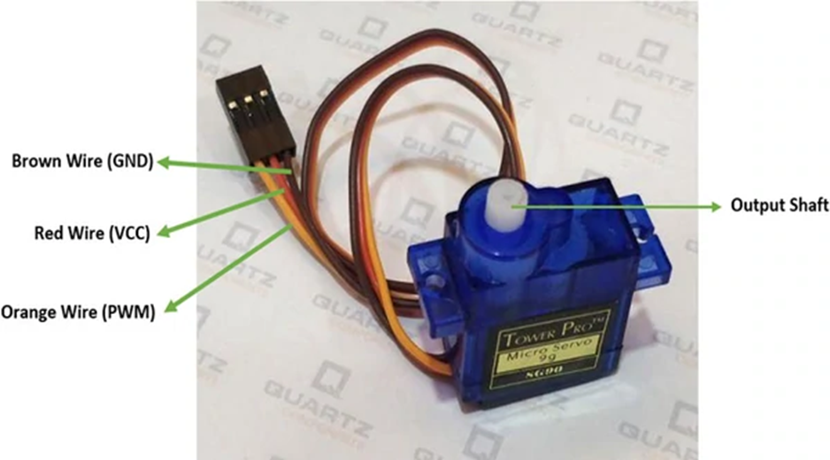
Servo motor

Slide 3
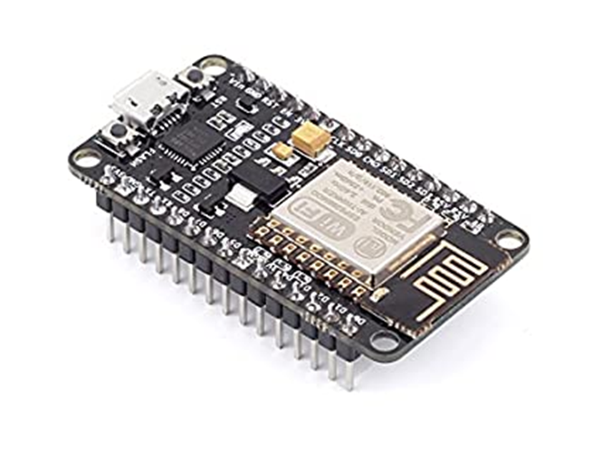
Nodemcu

Slide 4
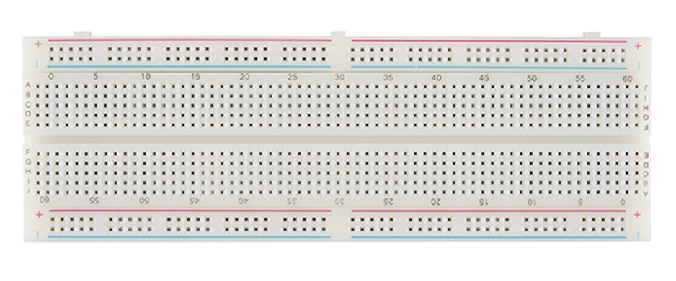
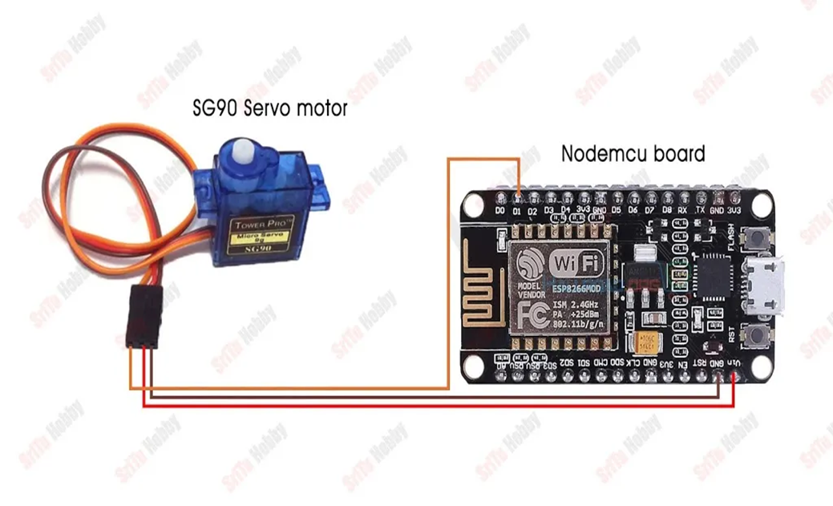
connections

Slide 5

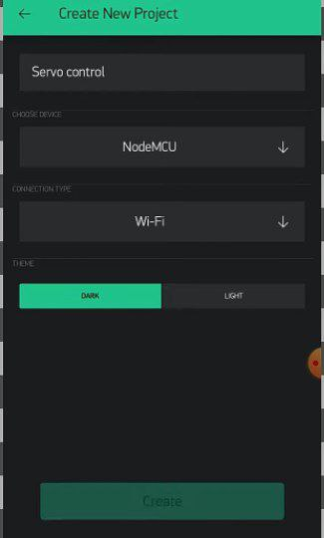
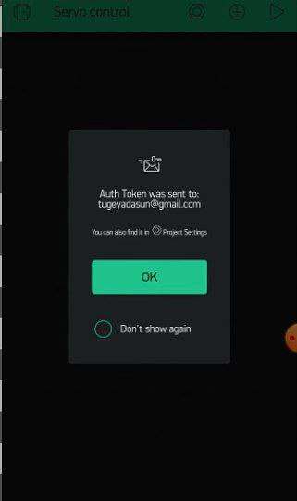
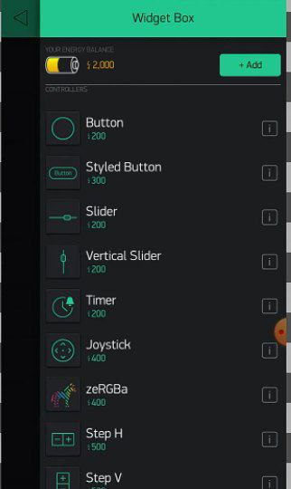
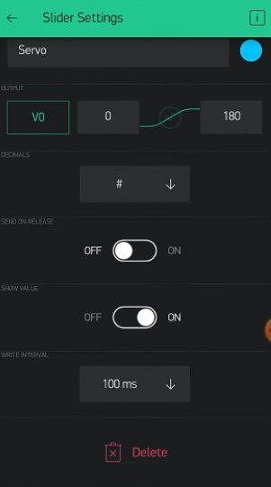

Slide 6
Arduino
Installation of libraries
Sketch → Include library →manage libraries →
Servo
Blynk
Esp8266

Slide 7
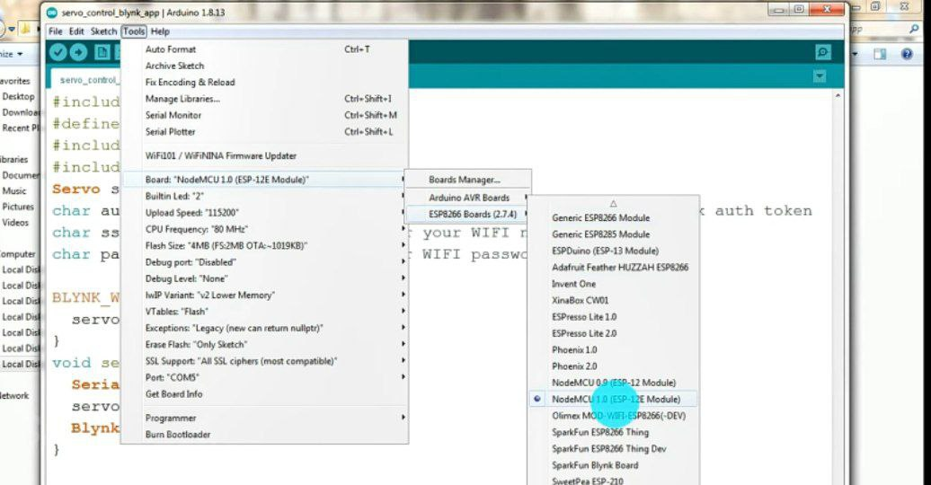
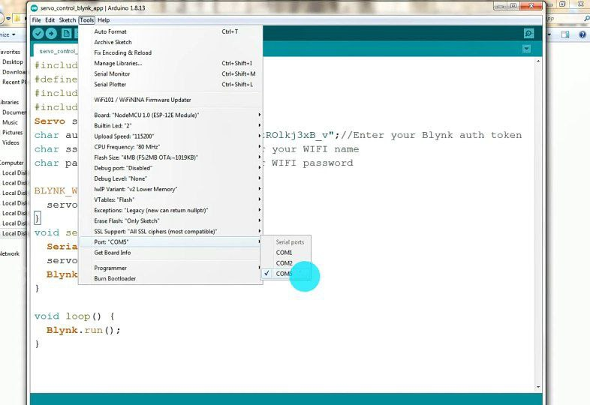
libraries

Slide 8
Code
#include <Servo.h>
#define BLYNK_PRINT Serial
#include <ESP8266WiFi.h>
#include <BlynkSimpleEsp8266.h>
Servo servo;
char auth[] = "iaqEf4XGrFswMR1C_vm2KzwotQu51pSL"; //enter your Blynk auth token
char ssid[] = "ZTE-Fjeg5C";//enter your wifi
char pass[] = "q2fe9rr5";//enter your wifi password
BLYNK_WRITE(V0){
servo.write(param.asInt());
}
void setup() {
Serial.begin(9600);
servo.attach(D1);
Blynk.begin(auth,ssid,pass);
}
void loop() {
Blynk.run();
}

